Slide 1
PROTECTING YOURSELF FROM PHISHING ATTACKS
Recognizing and Avoiding Phishing Emails, Websites, and Social Engineering Tactics

Slide 2

INTRODUCTION
Phishing is a type of cyber attack.
Involves tricking individuals into revealing sensitive information.
Importance of Phishing Awareness.

Slide 3
TYPES OF PHISHING ATTACKS
V
EMAIL PHISHING
WEBSITE PHISHING
SOCIAL ENGINEERING
Manipulating individuals to divulge confidential information
Deceptive emails to extract information
Fraudulent websites imitating legitimate ones
Examples: Fake security alerts, accountDeceptive emails to extract information
verification requests.
Examples: Fake login pages, malicious websites.
Examples: Impersonation, emotional manipulation.

Slide 4
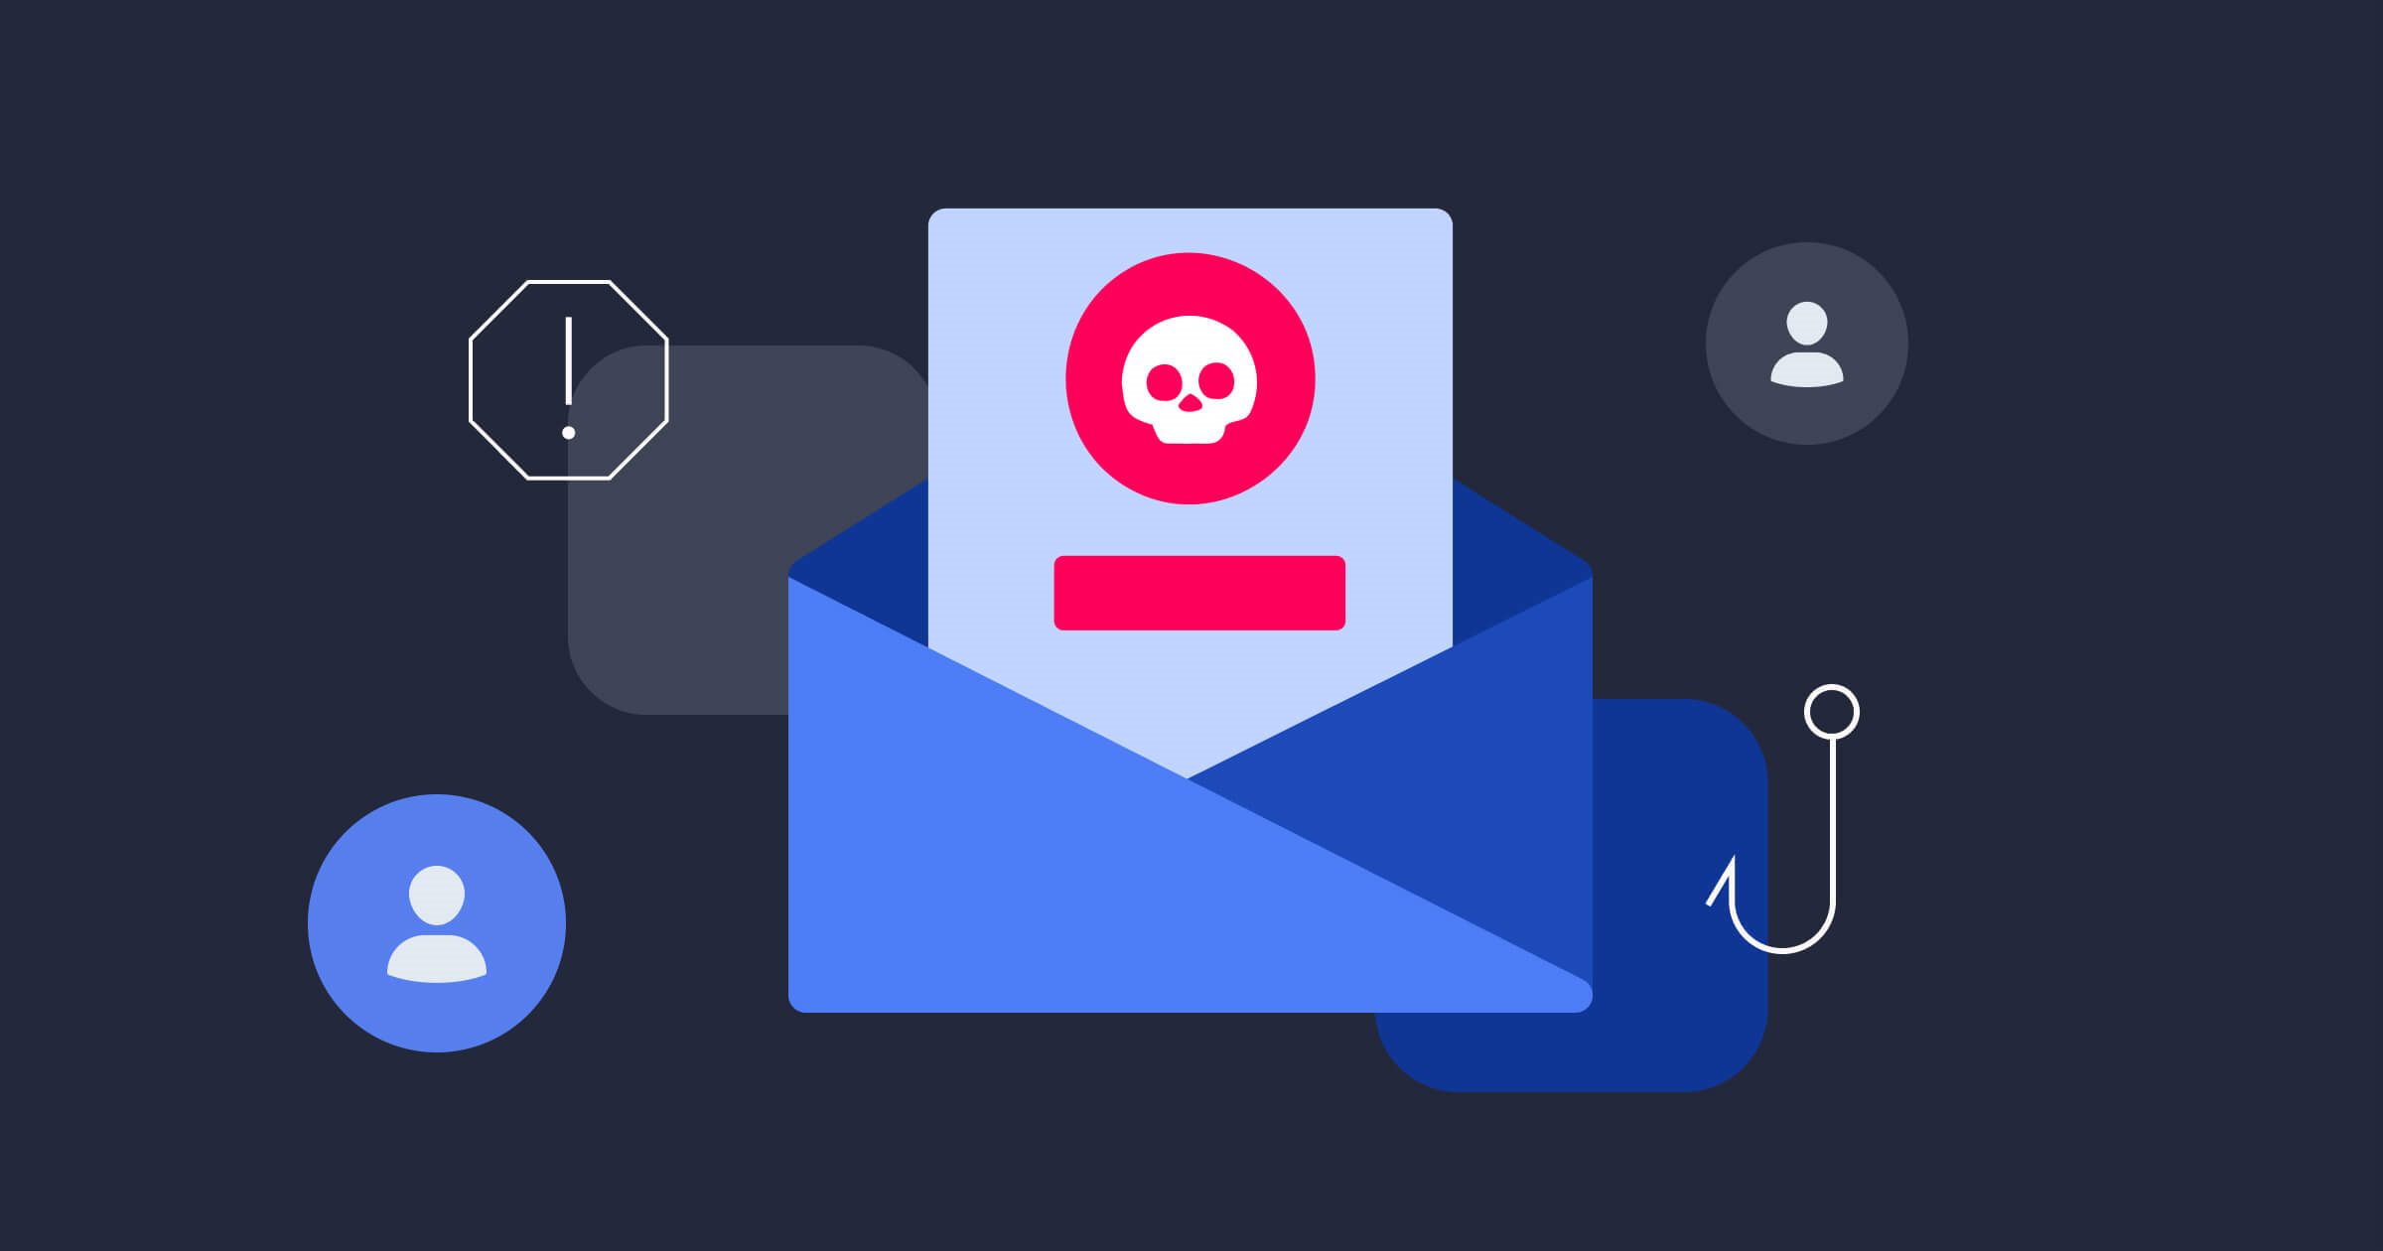
COMMON CHARACTERISTICS OF PHISHING ATTEMPTS
Urgency: Creating a sense of immediate action.
Unexpected Emails: Receiving unsolicited emails.
Suspicious Links: Hover over links to preview URLs
Requests for Personal Information: Be cautious.

Slide 5
RECOGNIZING PHISHING EMAIL
LOOK FOR SPELLING AND GRAMMER MISTAKES.
VERIFY EMAIL CONTENT.
HOVER OVER LINKS TO PREVIEW URLs.
CHECK THE SENDER’S EMAIL ADDRESS.

Slide 6
RECOGNIZING PHISHING WEBSITYES
Check the
URL.
Verify Website Legitimacy
Be Cautious
with Pop-Up
Forms.
Look for HTTPS.

Slide 7
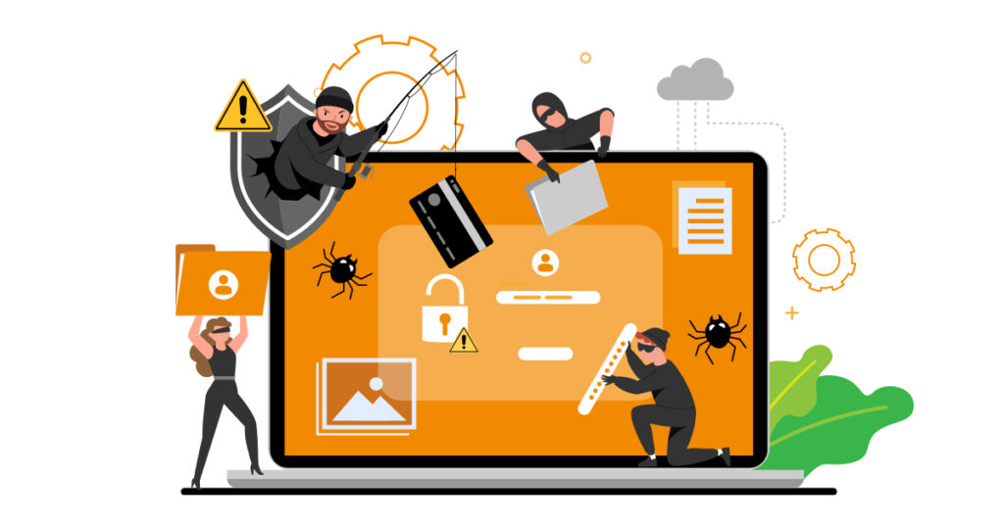
SOCIAL ENGINEERING TATICS
IMPERSONATION TECHNIQUES.
EXPLOITING HUMAN EMOTIONS
MANIPULATION OF TRUST
AWARENESS OF SOCIAL MEDIA MANIPULATION.

Slide 8

PROTECTING PERSONAL INFORMATION
Never Share Passwords via Email.
Use Two-Factor Authentication.
Verify Requests for Sensitive Information.
Be Cautious with Personal Information Sharing.

Slide 9
CASE STUDIES
Executive Impersonation for Sensitive Data:
Attack: Cybercriminals posed as high-level executives, requesting sensitive data from employees under the guise of urgent projects.
Impact: Confidential company information was exposed
Lessons Learned:
Communication Protocols: Define and enforce clear communication protocols for sensitive information requests, including verification measures.
Role-Based Training: Tailor phishing awareness training to different roles within the organization, emphasizing the potential for targeted attacks.

Slide 10
BEST PRACTICES FOR AVOIDING PHISHING
01
02
03
Educate and Train Employees.
Regularly Backup Important Data
Keep Software Updated and Use Security Software.

Slide 11

Q&A

Slide 12
THANKS YOU
I appreciate you time and engagement in todays presentationon protecting against phishing attacks

